Slide 1
Convolutional Neural Network
Dr. Nassim Sohaee

Slide 2
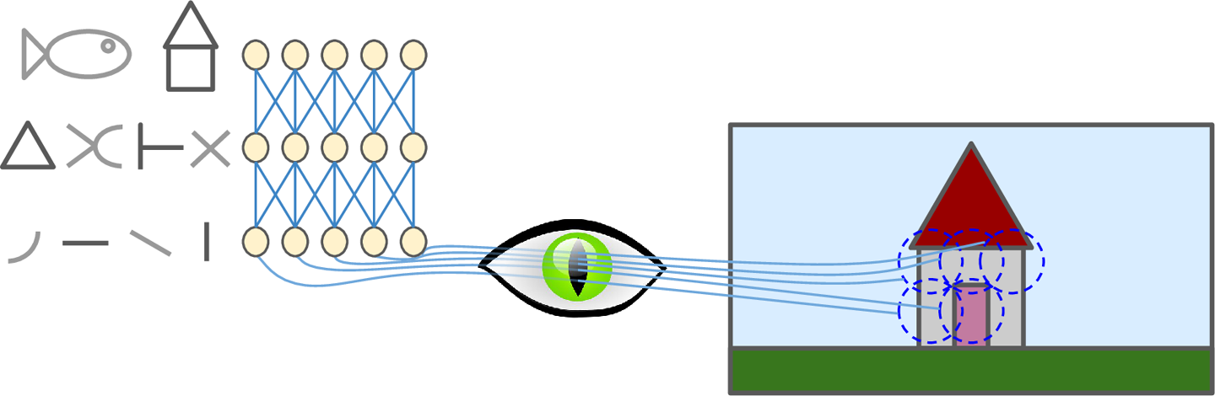
Nobel Prize in Physiology or Medicine in 1981

Slide 3
Note
Why not using deep neural network?
DNN is inefficient with large number of parameters

Slide 4
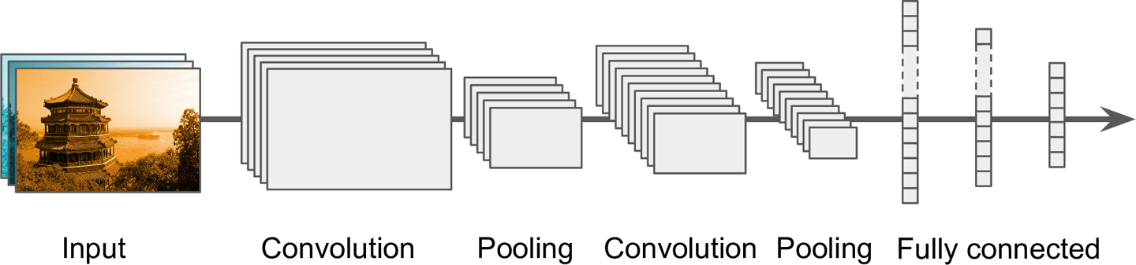
Convolutional Network Architecture

Slide 5
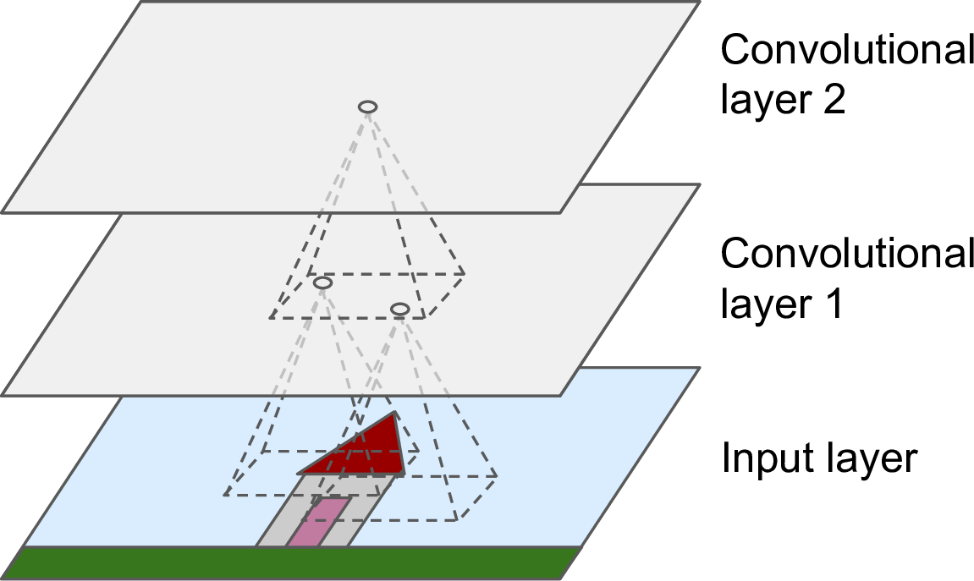
Convolutional Layer

Slide 6
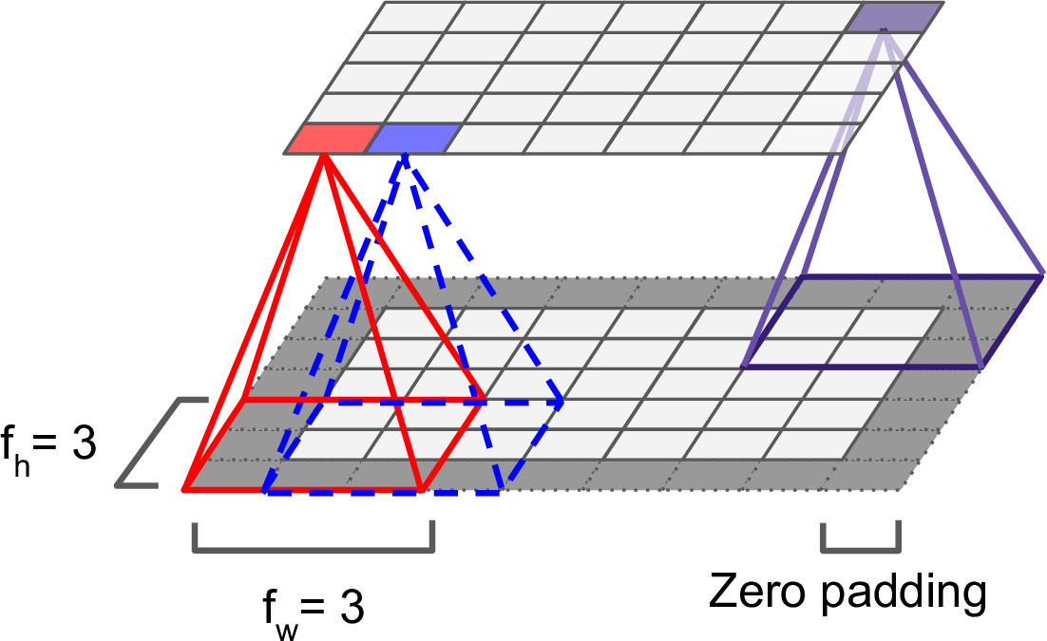

Slide 7
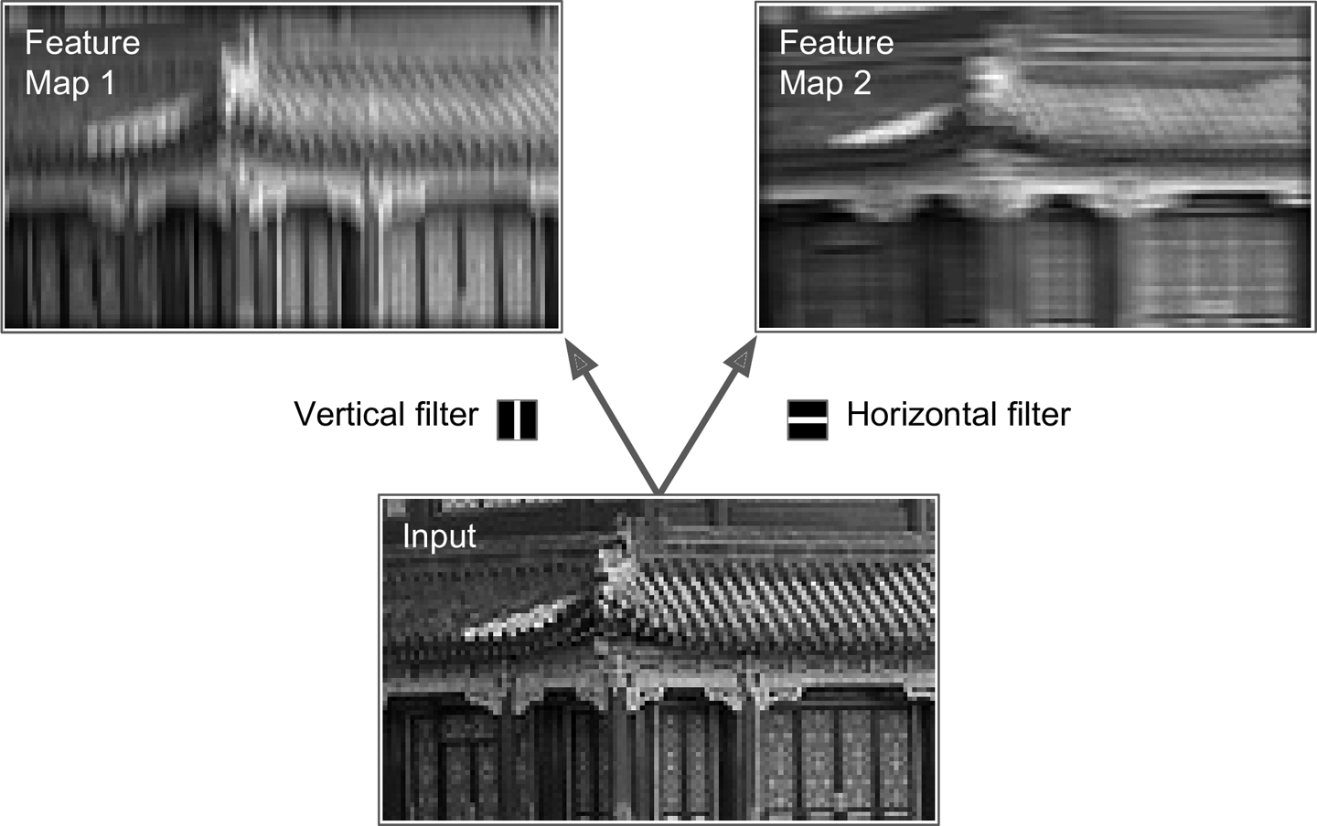
Filters

Slide 8
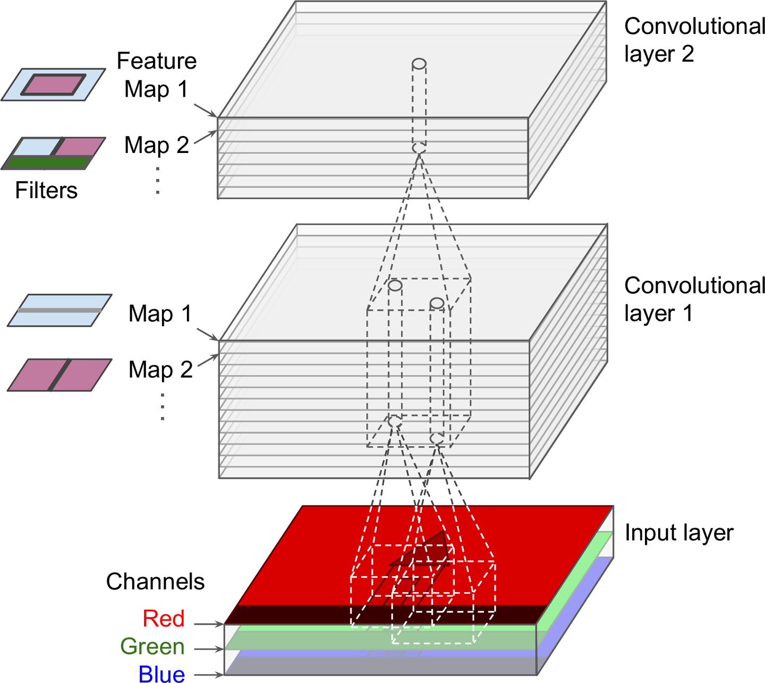
Multiple Feature Maps

Slide 9
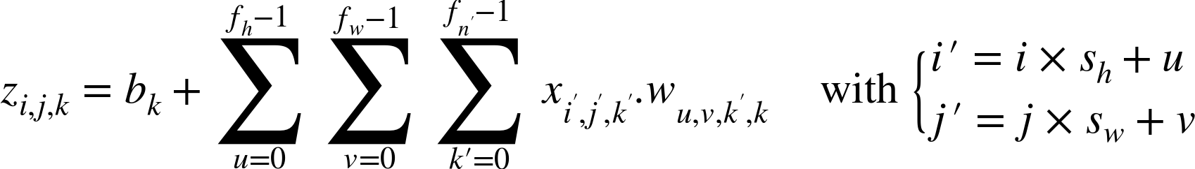

Slide 10
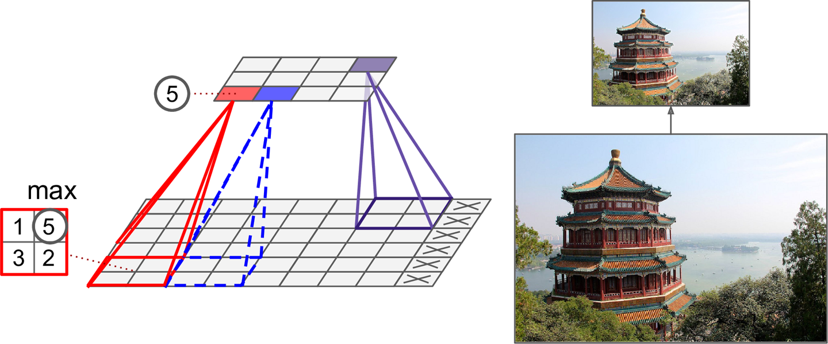
Pooling Layer

Slide 11
Dropout
Drop some of the neurons with probability of 1-p.
Dropout prevents overfitting

